Slide 1
DENVER RTD EAGLE P3
COMMUNICATION SYSTEM
OCC~PEI INTERFACE
2015. 12
WOOJIN INDUSTRIAL SYSTEMS CO., LTD.

Slide 2
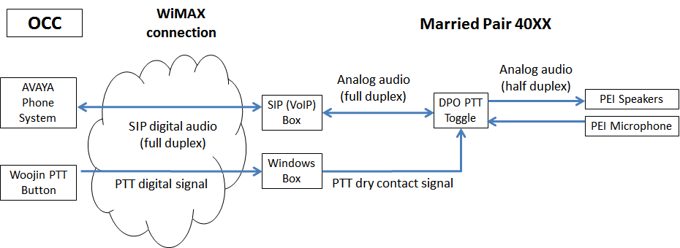
SUMMARY
Objective: To resolve the current OCC~PEI interface issue where the OCC system is full-duplex while the carborne system is half-duplex
Proposed Approach: To install IP-based PTT controller at OCC. The PTT controller will transmit control signals to the carborne system as a reference for switching between “talk” and “listen” modes
Supply Quantity: 5
Power Input: 110VAC commercial power
Physical Interfaces - LED: 4 (LINK, ACT, PWR, STATE) - S/W: 2 (One switch for IP addressing, One switch for PTT signaling) - Ethernet: 1
Functions - While OCC~PEI call is in progress, Woojin PTT controller will send “talk” and “listen” mode signals to the carborne system over the WiMax network - The carborne system will switch between two modes (talk/listen) as commanded from the PTT switch

Slide 3
PTT CONTROLLER BOARD BLOCK DIAGRAM
STATUS LED
STM32F4XX
MICROPROCESSOR
POWER
Input : 100VAC
Output : 5V, 3.3V
PWR-CON
IP-SET
Switch
PTT-SWITCH
Ethernet
PHY
Ethernet
Matching
Trans
RJ-45

Slide 4
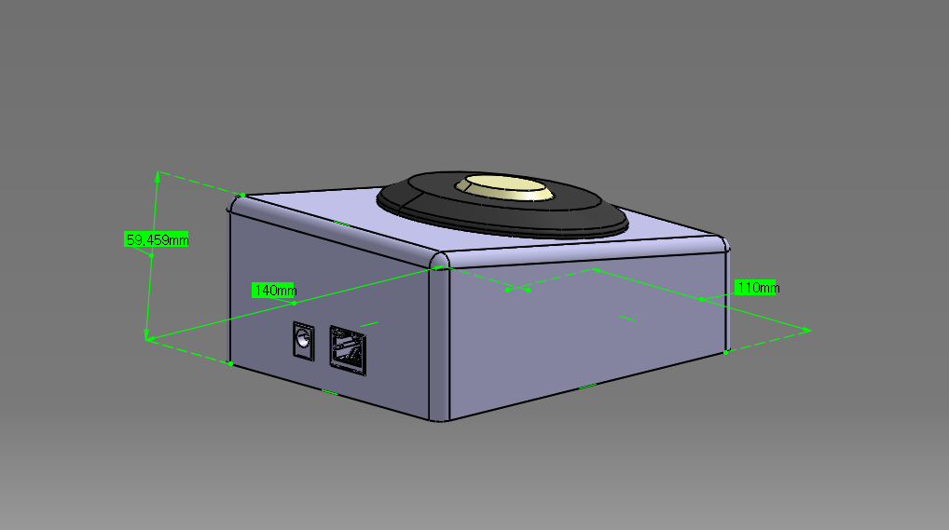
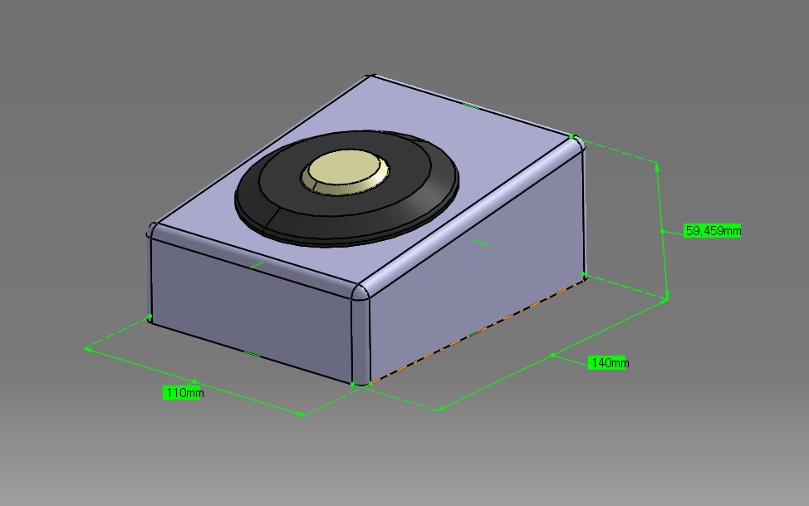
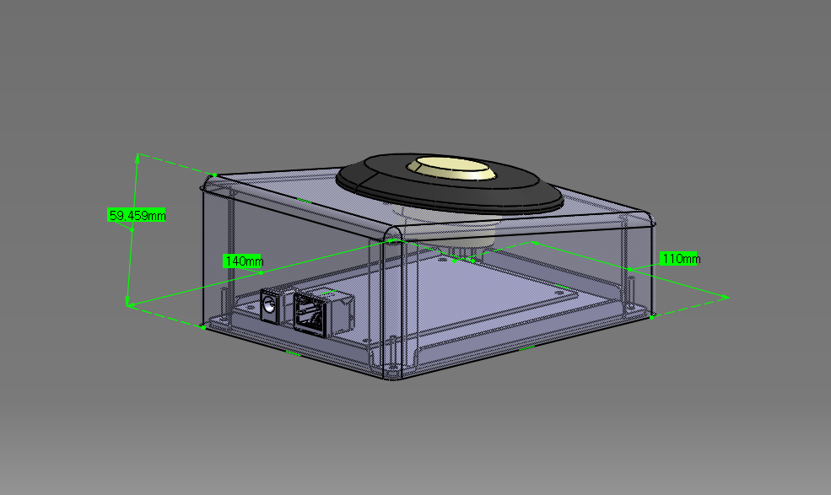
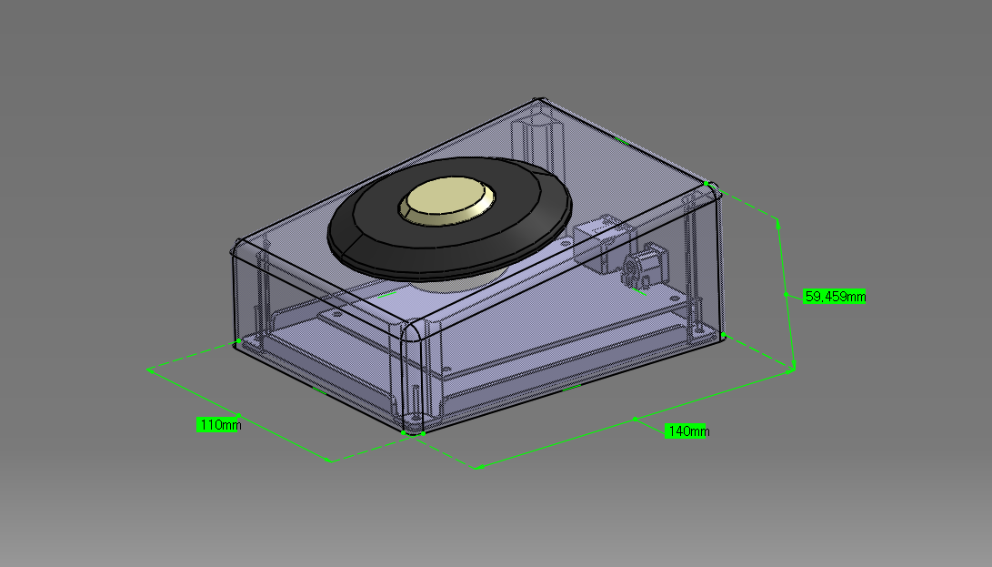
PROPOSED PTT CONTROLLER DESIGN
<Highlights>
Pushbutton Switch: EAO model 56-3113.2389
Enclosure: Aluminum
Powered by AC-DC adapter
RJ45 Ethernet port

Slide 5
DEVELOPMENT/IMPLEMENTATION SCHEDULE
1st prototype by 1/26/16 (both hardware and firmware)
Bench test at Woojin lab by 1/29/16
On-site demo and DTS/Rotem acceptance by week of 2/1/16 (with 1 controller)
Delivery of all 5 switches by end of Feb. 2016

